Slide 1
Music Recommendation
Guided By:- Presented by:
Prof: Neha Ramchandhani Ritisha Danole
Aditya Patidar
Anubhav Patel
Anandkumar Pal
Radhakrishna Yadav
Ashwin Patil
Nayankumar Mallick

Slide 2
Business Problem: POC for Recommendation Engine for a Yoga, Relaxation or Devotional Songs Music application targeted for Indian users Business objective- The aim of this project is to build a feature of recommendation system to support a music app. As the first phase we need to develop the proof of concept to make the client understand how effective the feature could be.

Slide 3
Project Architecture: Introduction :- A recommender system is a system which predicts ratings a user might give to a specific item. These predictions will then be ranked and returned back to the user. They're used by various large name companies like Google, Instagram, Spotify. Types of Recommendation system 1) Personalized Recommendation 2) Non-Personalized Recommendation

Slide 4
1]Personalized Recommendation:-Personalized recommender system analyzes users data, their purchases, rating and their relationships with other users in more detail. In that way every user will get customized recommendation. 2] Non-Personalized Recommendation:-While a personalized recommendation system suggests products to a user based on their previous purchase history, a non-personalized recommender system displays products that are popular among the people in general during that time period.

Slide 5
Data set details Dataset name: Songs_DataList.csv
 | Unnamed: 0 | artist_name | track_name | track_id | track_popularity | artist_id | danceability | energy | key | loudness
0 | 0 | Arijit Singh | Sawan Aaya Hai (From "Creature 3D") | 1xT7kYNyV29DUsYMsWn9yh | 6 | 4YRxDV8wJFPHPTeXepOstw | 0.515 | 0.671 | 10.0 | -7.510
1 | 1 | Arijit Singh | Kitni Haseen Hogi (From "Hit - The First Case") | 3GwKiQJwMXD2vFhTEN3N3r | 0 | 4YRxDV8wJFPHPTeXepOstw | 0.473 | 0.473 | 8.0 | -9.490
2 | 2 | Arijit Singh | Tum Hi Ho | 56zZ48jdyY2oDXHVnwg5Di | 70 | 4YRxDV8wJFPHPTeXepOstw | 0.528 | 0.449 | 5.0 | -6.250
3 | 3 | Arijit Singh | Hardum Humdum (From "Ludo") | 1KD6MUgh3DzLJ58UoJHOZL | 0 | 4YRxDV8wJFPHPTeXepOstw | 0.590 | 0.821 | 2.0 | -4.933
4 | 4 | Jeet Gannguli | Arijit Singh Mashup (By DJ Paroma) | 5Ox43gIWUNW6pAgx3F3oi7 | 51 | 2kkQthS9OLpK4UqNWYqoVl | 0.583 | 0.766 | 9.0 | -5.142
... | ... | ... | ... | ... | ... | ... | ... | ... | ... | ...
30896 | 995 | K. J. Yesudas | Iru Meyyum (From "Njangal Santhushtaranu") - M... | 7jZOBec7YctC09qmelQhgT | 5 | 2wPsNCwhEGb0KvChZ5DD52 | 0.444 | 0.477 | 0.0 | -13.334

Slide 6
EDA(Exploratory Data Analysis): 1]Music Information to check null values. 2]We Describe the data. 3]Data Understanding. 4]check the isnull values . 5] find correlational values.

Slide 7
Preprocessing: 1] Removed the repeated tracks. 2] Drop the unwanted values. 3]Drop unncecessary features. Visualizations:- 1] form a heatmap. 2]Shown by KDE plot. 3] Visualizing most popular track. 4] Visualising most popular Artist.

Slide 8
Model Building 1] Normalizing the data to get all the data in same scale for using Manhettan distance similarity for Recommending. 2] Select All the NON CATEGORICAL Features. 3]Form an elbow method we create a graph find k value. (For example, Arijit Singh songs won't be an accurate recommendation for Pankaj Udas songs.) That's why we will create a new feature, which would differ the songs from different groups. We will use KMeans clusterization with 10 clusters for this goal.

Slide 9
Model Training:- 1] Our class should understand which data to work with. 2] Function which returns recommendations, we can also choose the amount of songs to be recommended. 3] Choosing the data for our song. 4] Dropping the data with our song. 5] Indexes of non-numerical columns. 6] Calculating the manhettan distances for each numerical feature. 7] Sorting our data to be ascending by 'distance' feature.

Slide 10
Model Recommended:- 1]Song Recommendation. recommender = Spotify Recommender (music_data) recommender.get_recommendations('Lag ja Gale', 10) Recommended on basis of songs name. 2]Artist Recommendation. recommender_artist = Spotify Recommender_Artist(music_data) recommender_artist.get_recommendations_artist('Lata Mangeshkar', 10) Recommended on basis of Artist name.

Slide 11
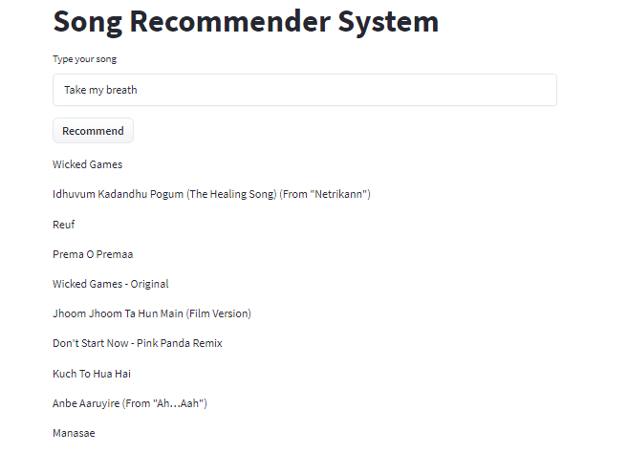
Model Deployment:-

Slide 12
Challenges faced: 1]While doing collection of data. 2]We faced some issues during coding. 3]To many choices are there. 4]Lack of data, changing of users preference. 5]There are too many choices.

